Slide 1

Agentic Design Patterns
April25
TradEx
Venali

Slide 2
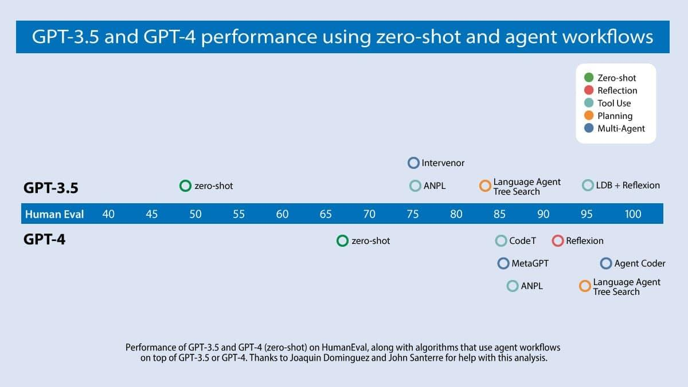

Slide 3
Agentic Design Patterns Part
Welcome & Introduction
💡
The Need for Agentic Workflows
The Iterative Process
Performance Gains Through Iteration
💻
📊
📣
Four AI Agent Strategies That Improve GPT-4 and GPT-3.5 Performance
- This series will explore four key design patterns for building AI agents that drive significant performance improvements. - These patterns are critical for enhancing outputs from models like GPT-4 and GPT-3.5. - Emphasize that agentic workflows go beyond zero-shot prompting by iteratively refining outputs.
The iterative workflow: - Plan an outline - Determine if web searches are needed - Write a first draft - Review and identify weaknesses - Revise and improve the draft Point: This iterative process mirrors how human writers produce high-quality text.
Traditional approach: LLMs generating final output token by token without revision.
Analogy: Writing an essay without backspacing or editing.
Limitation: Even though LLMs do well in zero-shot mode, iterative processes yield far better quality.
Transition: Introduce the concept of "Agentic Workflows" where the LLM is given multiple opportunities to improve its output.
GPT-3.5 in zero-shot mode: 48.1% correct
GPT-4 in zero-shot mode: 67.0% correct
Using an agent loop with GPT-3.5 can boost performance to up to 95.1% correct

Slide 4

Introducing the Four Design Patterns
Reflection
The LLM examines its own work and suggests improvements
Tool Use
The LLM leverages external tools (web search, code execution, etc.) to enhance output.
Planning
The LLM plans a sequence of steps before executing complex tasks.
Multi-Agent Collaboration
Multiple AI agents work together, each specializing in a specific subtask.

Slide 5
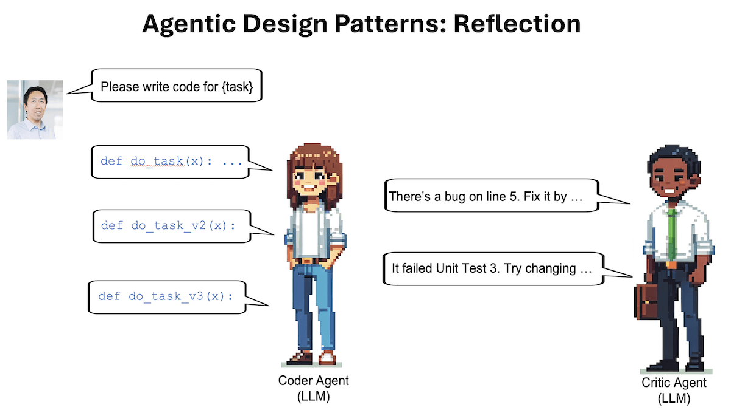

Slide 6
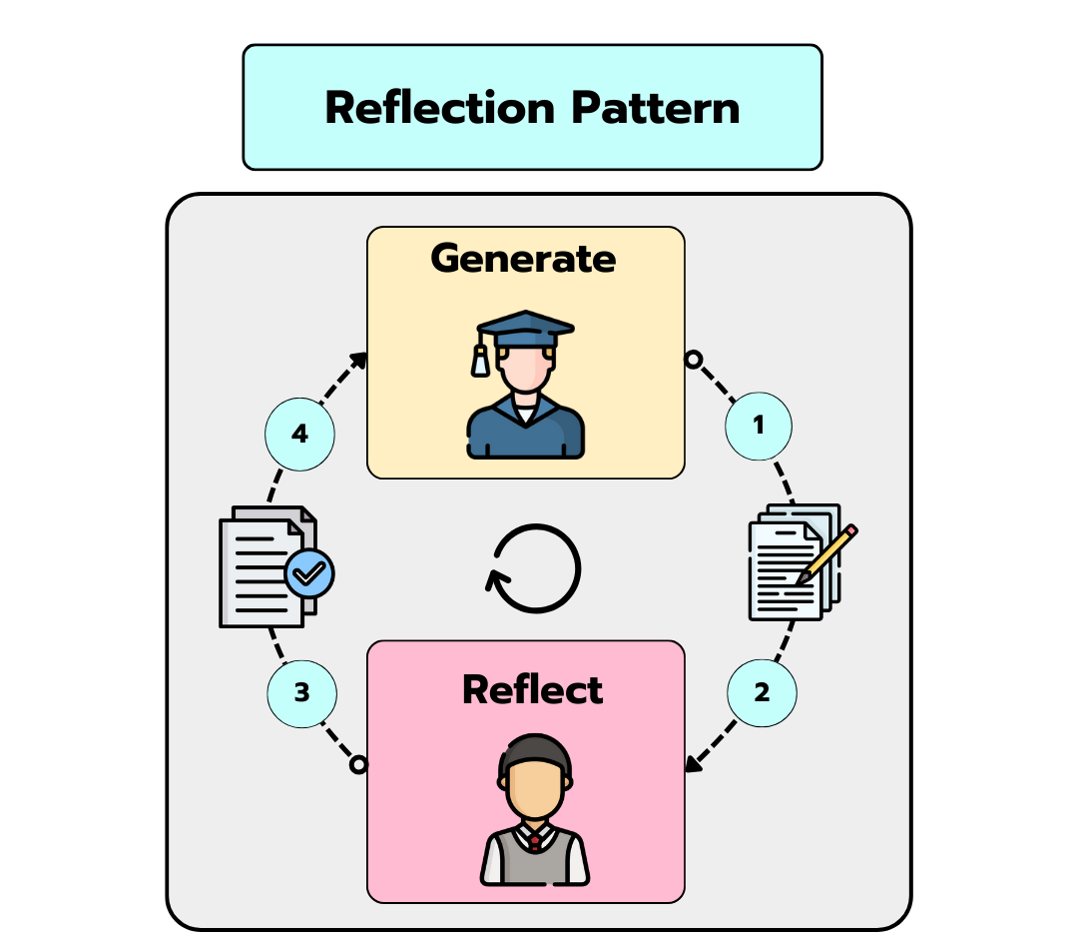
A very basic pattern but, despite its simplicity, it provides surprising performance gains for the LLM response.
It allows the LLM to reflect on its results, suggesting modifications, additions, improvements in the writing style, etc.

Slide 7
Introducing Reflection
Definition: Automating the process of self-criticism
Real-world example: Prompting ChatGPT/Claude/Gemini, then providing feedback to improve responses
Key idea: Let the model review its own output and suggest improvements

Slide 8
How Reflection Works in Practice
Example: Asking an LLM to write code for Task X
Step 1: Generate initial code
Step 2: Prompt the LLM: “Here’s code intended for Task X: [generated code]. Check for correctness, style, and efficiency; provide constructive criticism.”
Result: Model identifies issues and suggests improvements

Slide 9
Iterative Improvement
Process:
Generate output → Reflect → Critique → Rewrite
Repeating the cycle leads to even better output Application areas:
Code generation
Writing text
Answering questions

Slide 10
Enhancing Reflection with Evaluation Tools
Integrating unit tests to check code correctness
Using web search to verify text accuracy
Tools help the LLM evaluate and refine its output

Slide 11
Multi-Agent Framework for Reflection
Two-agent approach:
One agent generates output
Another agent provides constructive criticism
Resulting discussion leads to improved, refined responses

Slide 12
Performance Gains & Benefits
Reflection is quick to implement and yields surprising performance improvements
Enhances overall quality and robustness of LLM outputs
Versatile: Applicable to various tasks across industries

Slide 13
Further Learning & Resources
“Self-Refine: Iterative Refinement with Self-Feedback,” Madaan et al. (2023)
“Reflexion: Language Agents with Verbal Reinforcement Learning,” Shinn et al. (2023)
“CRITIC: Large Language Models Can Self-Correct with Tool-Interactive Critiquing,” Gou et al. (2024)

Slide 14
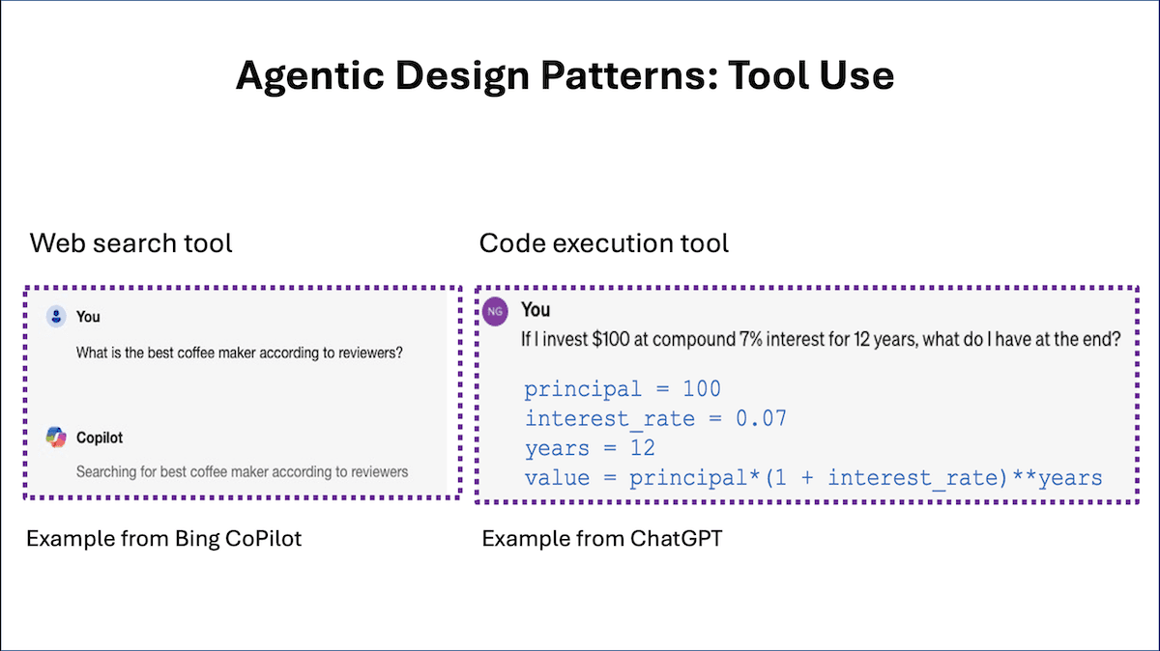

Slide 15
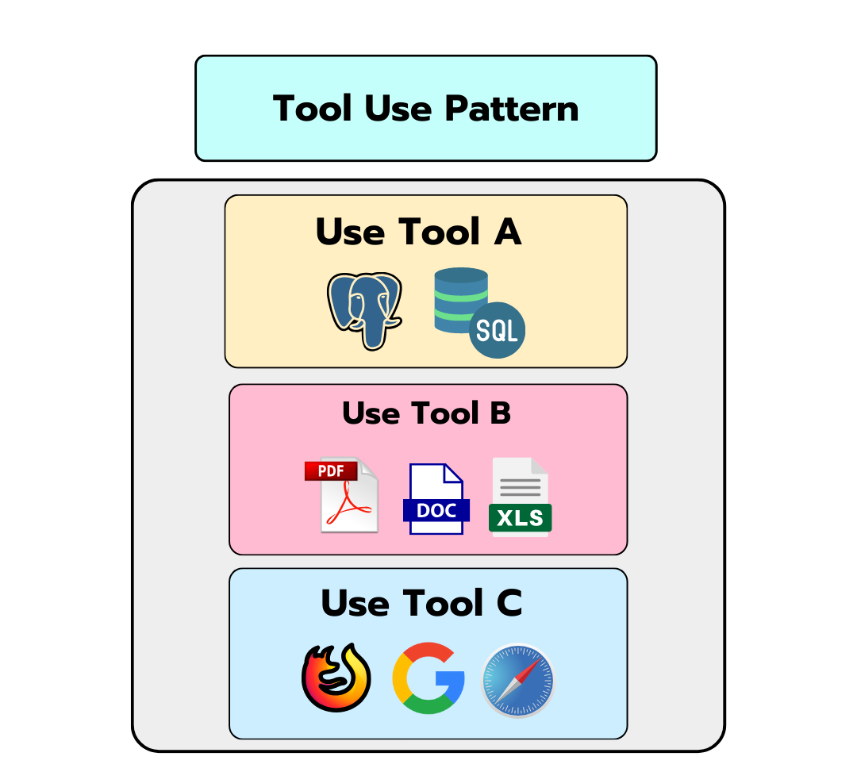
The information stored in the LLM weights is (usually) not enough to give accurate and insightful answers to our questions
That's why we need to provide the LLM with ways to access the outside world 🌍
In practice, you can build tools for whatever you want (at the end of the day they are just functions the LLM can use), from a tool that let's you access Wikipedia, another to analyse the content of YouTube videos or calculate difficult integrals in Wolfram Alpha.
Tools are the secret sauce of agentic applications and the possibilities are endless! 🥫

Slide 16
What is Tool Use?
Definition: A design pattern where an LLM is given functions it can call to gather information, execute code, or manipulate data
Examples:
Web search for context
Code execution for calculations
Emphasis: Goes beyond basic built-in capabilities of LLMs

Slide 17
How Tool Use Works – A Step-by-Step Example
Step 1: Ask the LLM a question (e.g., “What is the best coffee maker according to reviewers?”)
LLM generates a special string: {tool: web-search, query: "coffee maker reviews"}
Step 2: A post-processing step detects the string and calls the web search function
Step 3: The retrieved result is added as context for the LLM to produce a refined response

Slide 18
Code Execution Example
Scenario: Calculating compound interest
Initial prompt: “If I invest $100 at compound 7% interest for 12 years, what is the result?”
LLM generates: {tool: python-interpreter, code: "100 * (1+0.07)**12"}
The LLM calls a Python code execution tool to compute the answer
Result: Correct calculation based on external computation

Slide 19
Extending Tool Use Beyond Basics
LLMs can be equipped with functions for:
Searching multiple sources (web, Wikipedia, arXiv)
Interfacing with productivity tools (email, calendars)
Generating/interpreting images
In advanced scenarios:
The LLM may have access to hundreds of functions
Heuristics are used to select the most relevant tools for the current task

Slide 20
Evolution of Tool Use in LLMs
Early limitations: LLMs could not process images directly
Role of computer vision: Calling functions for object recognition, etc.
Breakthrough: GPT-4’s function calling capability as a general-purpose implementation
Trend: More LLMs are now integrating versatile Tool Use capabilities

Slide 21
Benefits and Impact
Performance Gains: Automating self-critical feedback leads to higher quality outputs
Versatility: Tool Use enables LLMs to perform diverse tasks (search, code execution, productivity)
Scalability: Efficient handling of many external tools through heuristics
Reliability: Consistent improvement in output quality when the process is repeated

Slide 22
Further Reading and Research
Recommended papers:
“Gorilla: Large Language Model Connected with Massive APIs” – Patil et al. (2023)
“MM-REACT: Prompting ChatGPT for Multimodal Reasoning and Action” – Yang et al. (2023)
“Efficient Tool Use with Chain-of-Abstraction Reasoning” – Gao et al. (2024)

Slide 23
Conclusion & Next Steps
Recap: Tool Use is a powerful design pattern that extends LLM capabilities significantly
Preview: Upcoming topics – Planning and Multi-Agent Collaboration (less mature but promising)
Encouragement: Keep learning and experimenting with these patterns in your projects

Slide 24
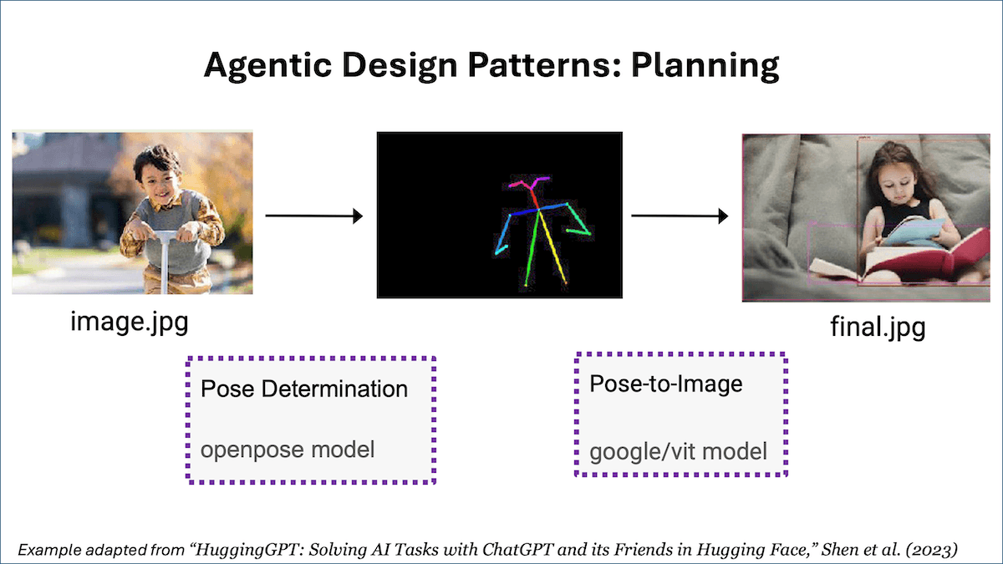

Slide 25
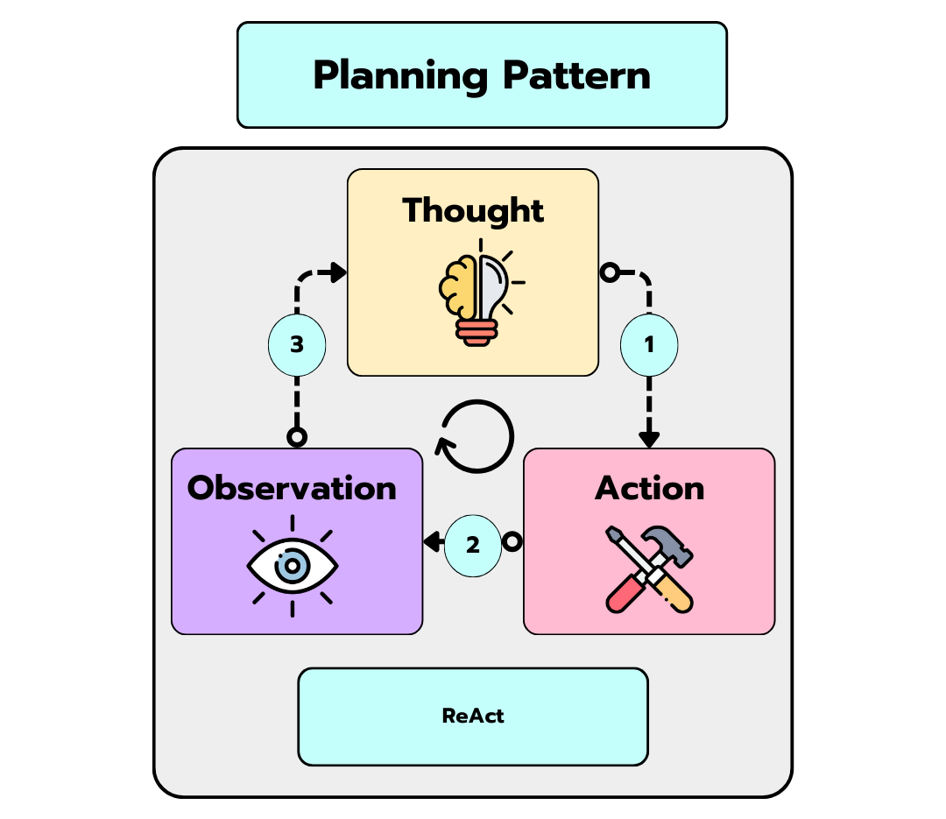
So, we've seen agents capable of reflecting and using tools to access the outside world. But ... what about planning, i.e. deciding what sequence of steps to follow to accomplish a large task?
That is exactly what the Planning Pattern provides; ways for the LLM to break a task into smaller, more easily accomplished subgoals without losing track of the end goal.

Slide 26
Introduction to Planning
Overview:
Planning is a key agentic AI design pattern
It uses a large language model (LLM) to autonomously decide on a sequence of steps for complex tasks
Importance:
Breaks down large tasks into smaller subtasks
Leads to higher quality outputs when steps are planned before action

Slide 27
How Planning Works
Example Scenario: Online Research
Task: Research a topic online
Planned Steps:
Research specific subtopics
Synthesize findings
Compile a report
Key Benefit:
Dynamic decomposition when pre-defining steps isn’t possible

Slide 28
Detailed Example – Image Pose Task
Task: Convert a picture of a boy into a picture of a girl in the same pose
Planned Decomposition:
Detect the pose in the picture of the boy
Render a picture of a girl using the detected pose
Process:
LLM generates a structured plan with tool calls
Example output: {tool: pose-detection, input: image.jpg, output: temp1} {tool: pose-to-image, input: temp1, output: final.jpg}
Result:
Sequential tool execution improves output quality

Slide 29
Advantages & Challenges of Planning
Advantages:
Empowers LLMs to handle complex, multi-step tasks
Allows dynamic decision-making when tasks are unpredictable
Challenges:
Planning can lead to less predictable outcomes compared to fixed processes
Technology is less mature than Reflection and Tool Use
Requires careful design to balance flexibility and reliability

Slide 30
Future of Planning in AI
Rapid evolution in planning capabilities
Ongoing research to improve predictability and reliability
Integration with other design patterns (Reflection, Tool Use, Multi-agent collaboration)
Exciting prospects for more robust, agentic AI applications

Slide 31
Further Reading & Resources
“Chain-of-Thought Prompting Elicits Reasoning in Large Language Models” – Wei et al. (2022)
“HuggingGPT: Solving AI Tasks with ChatGPT and its Friends in Hugging Face” – Shen et al. (2023)
“Understanding the Planning of LLM Agents: A Survey” – Huang et al. (2024)

Slide 32
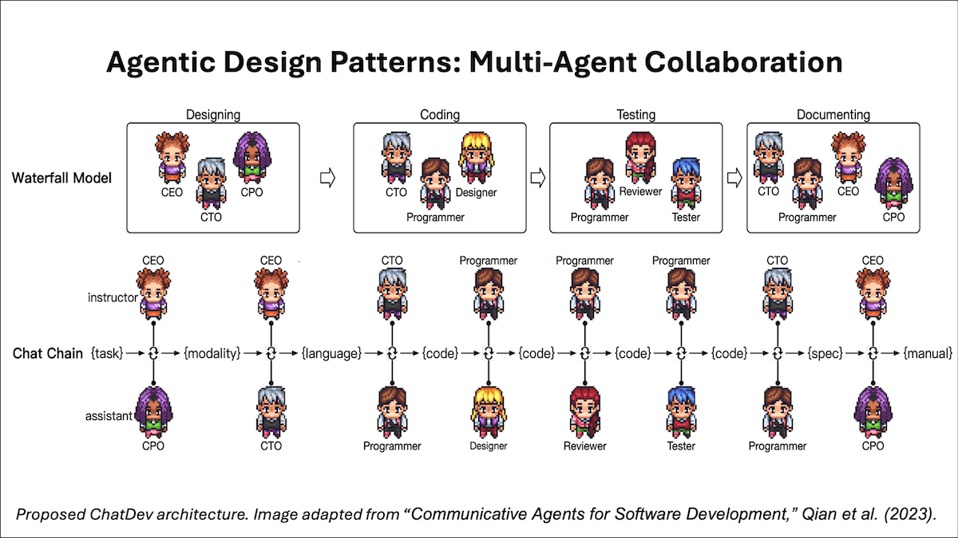

Slide 33
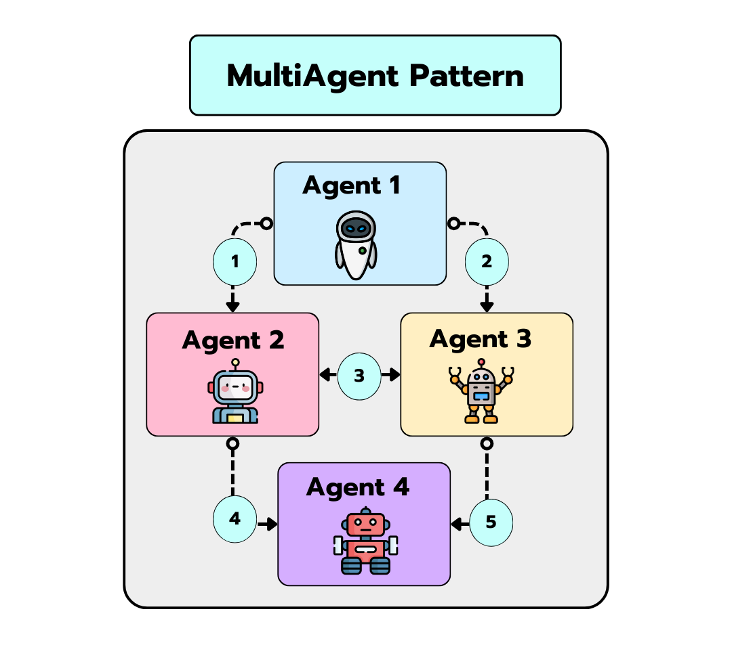
Multi-agent applications frameworks implement different variations of the multi-agent pattern, in which tasks are divided into smaller subtasks executed by different roles (e.g. one agent can be a software engineer, another a project manager, etc.)

Slide 34
What is Multi-Agent Collaboration?
Definition: Prompting an LLM to play different roles for different parts of a complex task
Analogy: Like hiring a team of experts (e.g., software engineer, product manager, designer, QA)
Purpose: Break down complex tasks into manageable subtasks handled by specialized agents

Slide 35
How Multi-Agent Collaboration Works
Step 1: Task Decomposition
LLM is prompted to break a large task into smaller, distinct subtasks
Step 2: Role Assignment
Each subtask is assigned to a specific “agent” (via tailored prompts)
Step 3: Independent Execution
Agents execute their tasks with their own workflows and memory
Step 4: Interaction & Coordination
Agents exchange information, call on planning and tool use as needed

Slide 36
Example Use Case: Software Development
Task: Build a software application
Decomposed Roles:
Software Engineer Agent: Write clear and efficient code
Product Manager Agent: Define requirements and priorities
Designer Agent: Create UI/UX concepts
QA Agent: Test and validate code quality
Result: Each agent focuses on its area, resulting in better overall performance

Slide 37
Advantages of Multi-Agent Collaboration
Improved performance compared to single-agent systems
Enhanced focus on subtasks leading to higher quality output
Flexibility: Agents can request help or delegate tasks to other agents
Familiar mental framework: Similar to managing a human team with specialized roles

Slide 38
Challenges & Considerations
Unpredictable outcomes: Multi-agent interactions can be less deterministic
Complexity: Managing multiple LLM calls and message passing
Maturity: Planning and Multi-Agent Collaboration are evolving, less reliable than Reflection or Tool Use
Ongoing research: Emerging frameworks like AutoGen, Crew AI, and LangGraph are pushing this space forward

Slide 39
Emerging Frameworks & Tools
Brief overview of key frameworks:
AutoGen: Enabling next-gen LLM applications via multi-agent conversation
Crew AI: Building teams of agents for complex tasks
LangGraph: Visualization and management of multi-agent workflows
Mention: ChatDev as an open source implementation of a virtual software company
Encourage exploration and experimentation

Slide 40
Recommended Reading
“Communicative Agents for Software Development” – Qian et al. (2023)
“AutoGen: Enabling Next-Gen LLM Applications via Multi-Agent Conversation” – Wu et al. (2023)
“MetaGPT: Meta Programming for a Multi-Agent Collaborative Framework” – Hong et al. (2023)

Slide 41
Thank You
Contact
Venali Sonone
venalisono@gmail.com

